Slide 1
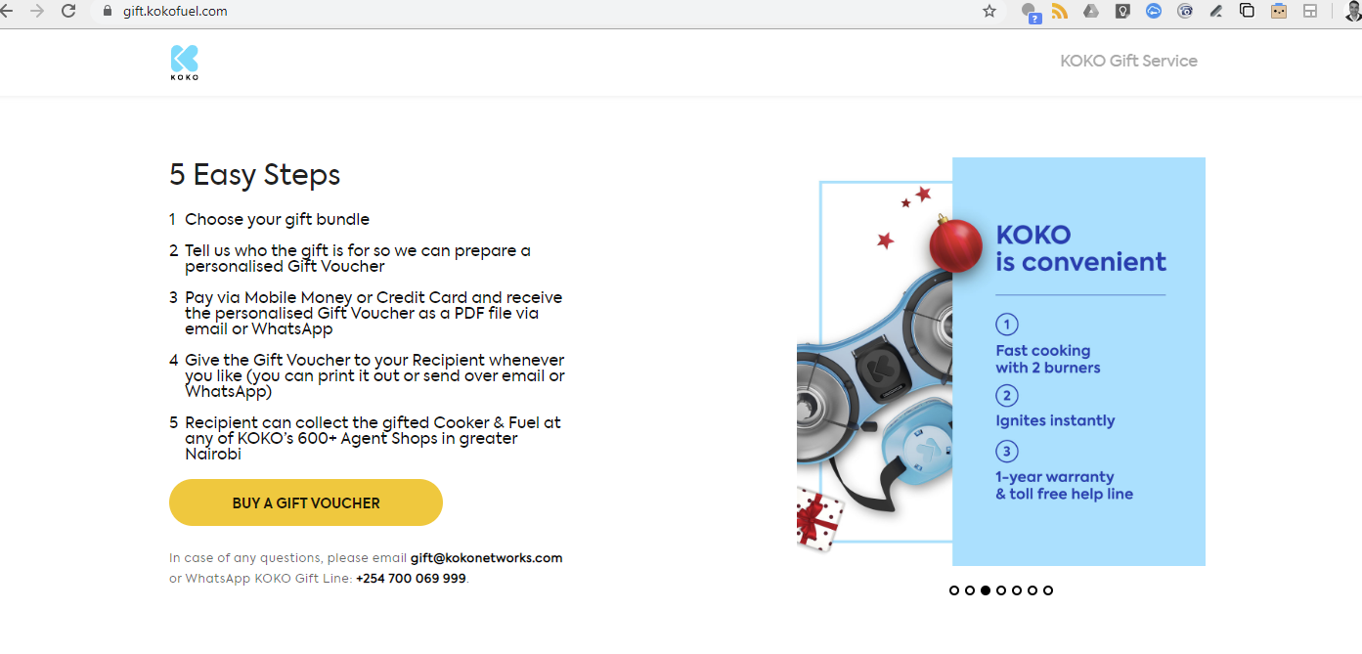
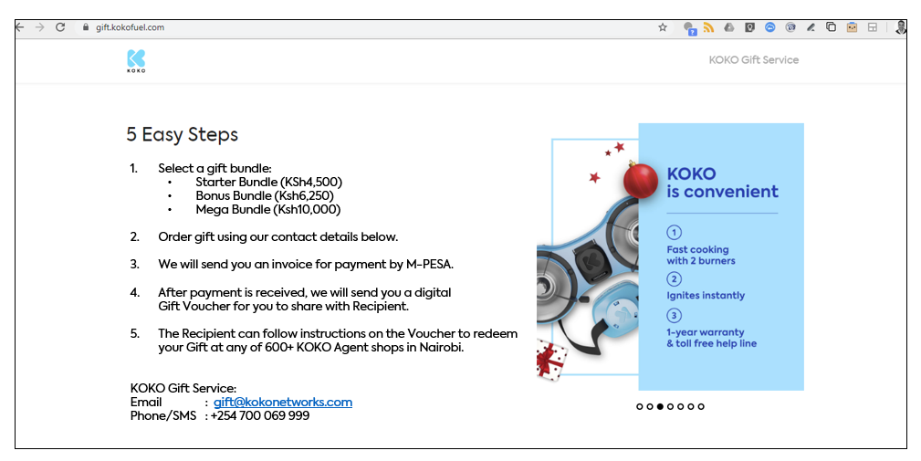
Current Gift Home Page
Modified Gift Home Page (see next slide)
Updated text

Slide 2
Modified Gift Home Page (with updated text)
Select a gift bundle:
Starter Bundle (KSh4,500)
Bonus Bundle (Ksh6,250)
Mega Bundle (Ksh10,000)
Email us indicating which bundle you want to order and name of the Gift Recipient.
We will send you an invoice for payment by M-PESA.
After payment is received, we will send you a digital Gift Voucher for you to share with Recipient.
The Recipient can follow instructions on the Voucher to claim your Gift at any of 600+ KOKO Agent shops in Nairobi.
KOKO Gift Service:
Email : gift@kokonetworks.com

